Slide 1
CITY MANAGER’S REPORT
September 9 - 13, 2024

Slide 2
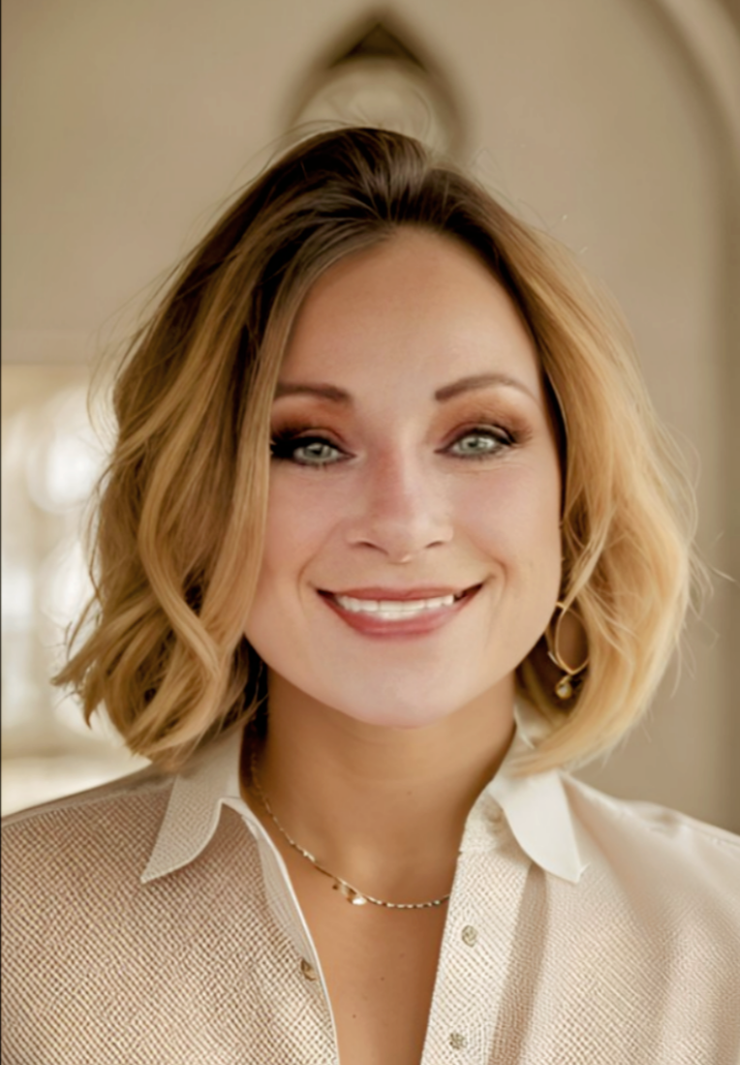
A Letter From The City Manager
Greetings City of Bowling Green:
As we approach the end of yet another successful year,
I am extremely proud of all the significant accomplishments and milestones that have been achieved together as ONE community. The ongoing energy and momentum being felt throughout Bowling Green’s municipality is something that simply can’t be ignored. It is you, our incredible residents, elected officials, city employees, business owners, teachers, volunteers, religious clergy and countless others who have contributed to the city’s overall success. For that, you should all be commended.
For our CRA area, I am also pleased to report that this past year, we were able to launch our Façade Grant Enhancement Program. Thanks to Mayor N’Kosi Jones and the City Commission, the program allocated $160,000 in grant funding for qualifying residents and businesses. I can’t thank of a better way to give back to those who have given so much to our beloved community.
In closing, I’d like to thank our city staff and most importantly, the great residents for entrusting me to lead this city to its next great height. Although there is still much work to be done, I am beyond confident that there is nothing we cannot accomplish if we work together.
Pamela Durrance
Pamela Durrance
City Manager
Pamela Durrance
City Manager

Slide 3
City Manager
On August 29th I was appointed to serve on the Florida League of Cities 2024-2025 Development, Code Compliance, and Redevelopment Committee, Legislative Policy Committee chairs, vice chairs and members were appointed by Florida League of Cities
President Michael C. Blake, Mayor of Cocoa.
September 9, 2024,
FLCitiesStrong September Webinar on zoom
City Clerk interview
September 10, 2024,
Bowling Green City Commission held its scheduled meeting. The agenda items were as follow: WWTF Advanced Wastewater Treatment for Public Access Reuse, Holy Child Utility Agreement, Presentation of City Accomplishments to Date
FLC Legislative Policy Committees 101 on zoom
City of Bowling Green Disaster Funding on zoom
September 11, 2024
I had the opportunity to attend a Rotary luncheon, where I was invited by Mr. Tommy Griffin, Congressman Franklin’s field representative for the 18th District. Following the luncheon, I met with Mr. Griffin at my office to discuss the ongoing projects within the City of Bowling Green and potential future initiatives that Congressman Franklin could support.
Cybersecurity Specialist Kickoff Meeting on zoom
Grant Match on zoom
Meet with Sheriff Crawford and Col. Roberts for animal services
September 12, 2024
Sams. Gov for UEI# for the Police Department grant
Meeting with administrative staff on next week goals
5

Slide 4
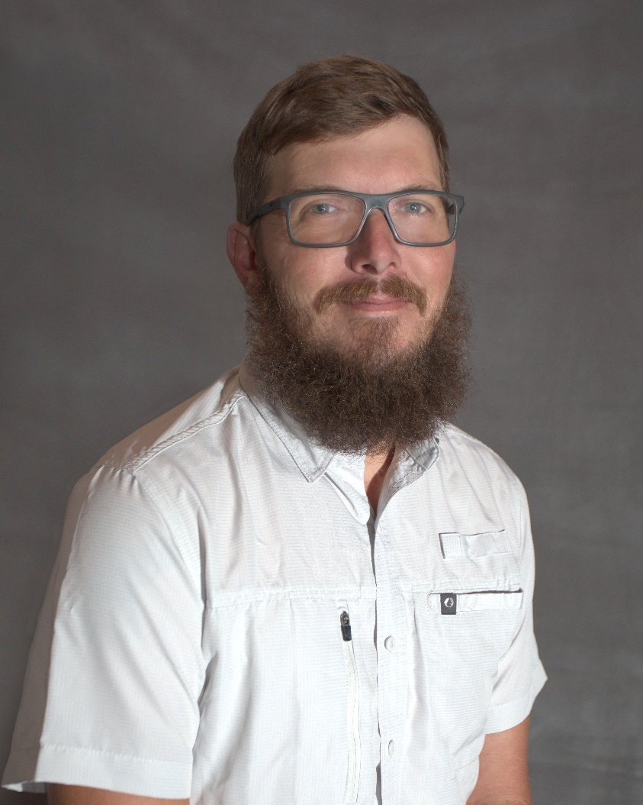
Public Works
MONDAY 9/16/24
CLAW TRUCK IS DOWN FOR REPAIR
WEEDEAT DIXIANA, PINEAPPLE, DOC COIL AND CHESTER MAIN ST DITCHES NEXT TO PARK, FINISH MOWING PYATT PARK
TUESDAY 9/17/24
DIG UP ASPHALT, SHELL ON MAPLE, DIG UP OLD RUSTY CULVERT, PUT OUT BARRICADES TO BLOCK OFF DITCH LINE, SEWER PROBLEM AT 18 LYNN ST,
MOWED DRYING BEDS AT SEWER PLANT, MOWED PINE,MAPLE,DIXIANA, PINEAPPLE,FIRST, WEEDEAT ON DIXIANA, CHESTER AVE, BERTHA FULSE & SNELLING, HELP WAYNE PICKUP & DROP OFF BARRICADES ON MAPLE AVE, MOW/WEEDEAT JONES ST FLOWER BEDS, CEMETERY
WEDNESDAY 9/18/24
DIG UP REMAINING DIRT FOR NEW CULVERT PLACEMENT ON MAPLE, COVER UP, SET UP BARRICADES TO CLOSE ROAD BACK OFF,
WEEDEAT CHESTER & DOC COIL, WEEDEAT AT SHOP, FIRST, FAIR AVE, EAST MAIN ST, SEWER PLANT / WATER PLANT
THURSDAY 9/19/24
MOW AND WEEDEAT ON MAIN ST SIDEWALKS, DITCHES, PICK UP LIMBS/DEBRIS, PICK UP OLD CULVERT AND TAKE TO PILE, SOUTHWEST SECTION OF TOWN
CHECKED DRAINAGE AT MLK & COUNTY LINE RD, FILL SEVERAL HOLES THROUGHOUT TOWN FOR METER BOXES, FIXED DRAINAGE ON END OF MAPLE AVE, CLEAN OUT CULVERT ENDS
FRIDAY 9/20/24
MOW/WEEDEAT ON
PICK UP PILES OF LIMBS IN PREPARATION FOR POSSIBLE HURRICANE
WORK ON MLK/COUNTY LINE CULVERT
Public Works
Hunter Brummett

Slide 5
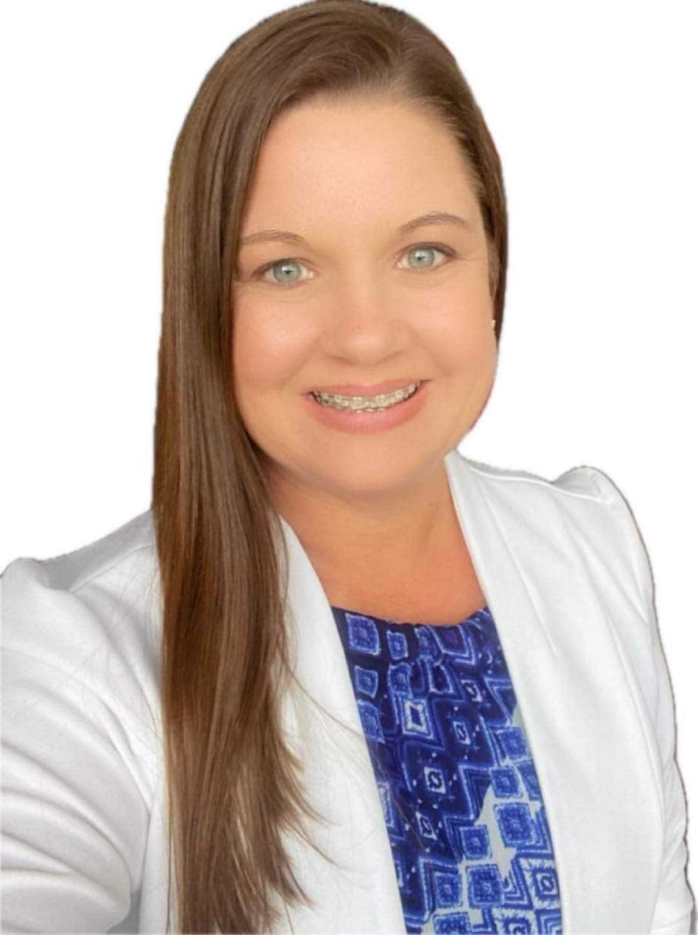
City Clerk
OPEN RECORDS REQUESTS:
TOTAL OPEN RECORDS REQUEST RECEIVED =0
COMPLETED REQUESTS=0
CANCELED REQUESTS=0
GENERAL REQUEST:0
POLICE REQUEST:0
UPCOMING EVENTS:
OCTOBER 19, 2024: HARVEST FESTIVAL/TRUNK OR TREAT
OCTOBER 21-27, 2024: FLORIDA CITY GOVERNMENT WEEK
UPCOMING MEETINGS
SEPTEMBER 23, 2024 VOLUNTEER RECREATION COMMITTEE
SEPTEMBER 27, 2024 SPECIAL MEETING FRDAP
SEPTEMBER 30, 2024: FINAL TRIM MEETING
OCTOBER 1, 2024: SPECIAL MEETING (THE ACQUISITION OF CERTAIN REAL PROPERTY)
OCTOBER 8, 2024: REGULAR COMMISSION MEETING
City Clerk
Charlette Ganas
Human Resource
Open Positions
# of advertised positions

Slide 6
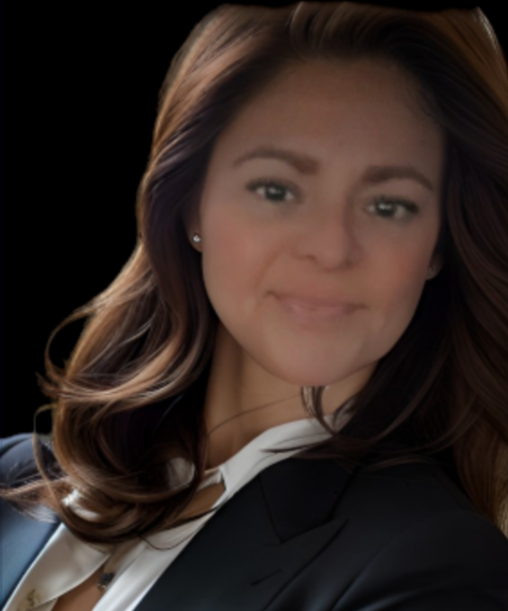
Finance
The Finance Manager is currently in the final stages of finalizing the city's budget, ensuring all financial allocations align with the strategic goals for the upcoming year. Alongside the budget preparation, diligently compiling the necessary documentation and financial statements for the annual audit. This comprehensive process requires a detailed review of all transactions and accounts, ensuring accuracy and compliance. Throughout these key tasks, have also managed to oversee and process the timely payment of bills, maintaining the smooth operation of day-to-day finances. With multiple critical projects demanding attention simultaneously, also meet all deadlines.
Payroll was on Thursday as usual, calling to pay payroll taxes and do journal entries to offset payroll expenses.
07
06
Finance Director & Billing
Vicki Gordillo

Slide 7
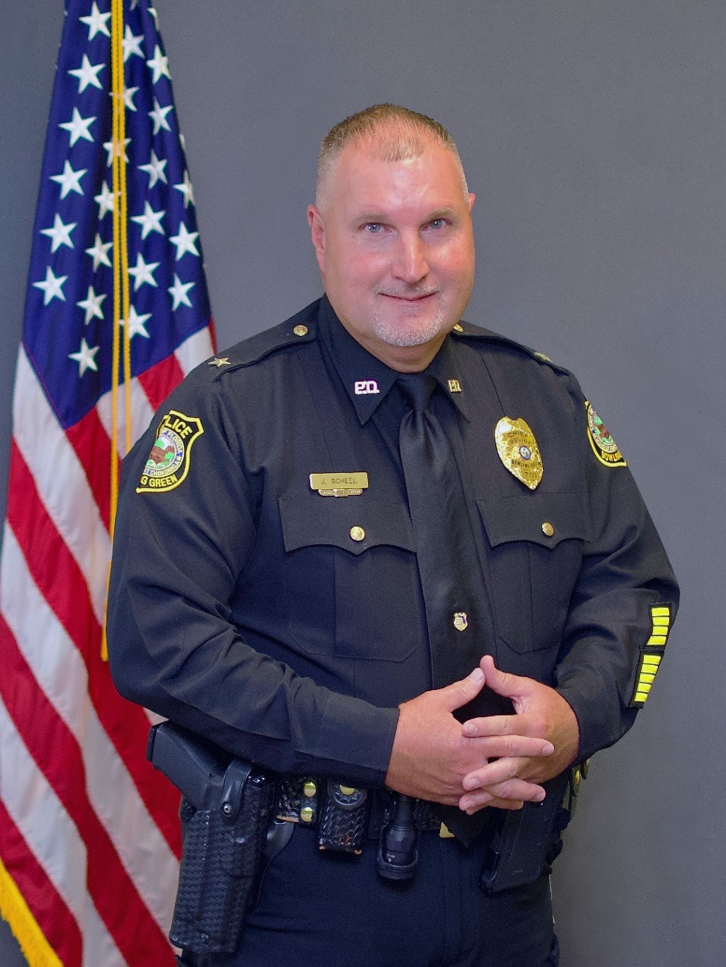
Police
Police News:
Chief and City Manager met with Hardee County Sheriff Crawford to talk about contracting the animal services to Hardee County.
POLICE STATS
Traffic Stops | 11
Citations | 7
Warnings | 5
Arrests | 2
Calls for Service | 44
Police Chief
John Scheel

Slide 8
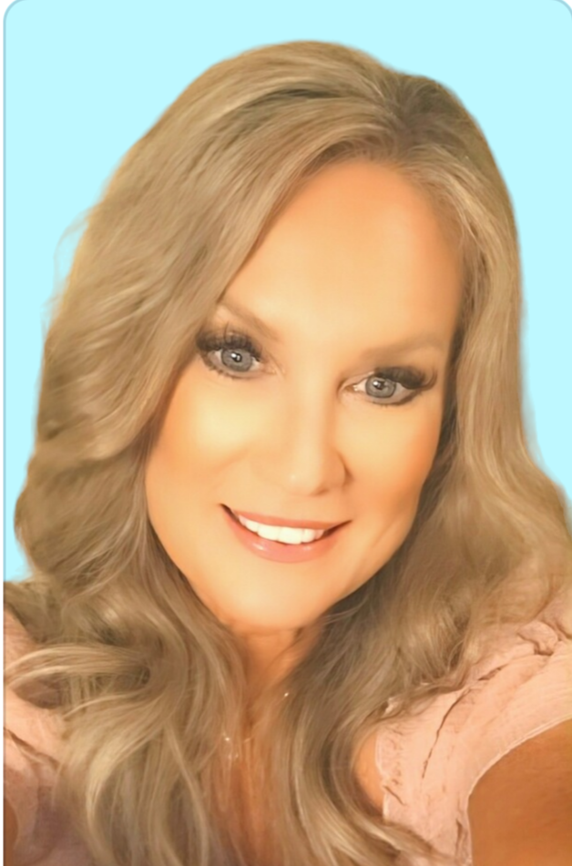
Planning & Community Development
PERMITS ISSUED
STRUCTURE TYPE | TOTAL
RESIDENTIAL | 5
COMMERCIAL | 3 (SITE PLAN IN REVIEW)
Dawn Stark
Code Enforcement
Code Enforcement
CODE VIOLATIONS
VIOLATIONS | # OF CASES | RESOLVED | OPEN
Code Inspections | 6 |  | 6
Code Letters | 2
Zoning Review/Sign Offs | 5

Slide 9
Human Resource
Open Positions
Department
# of advertised positions
1. Public Works/Fleet
2. Police
1-Animal Services (Resigned)

